Slide 1
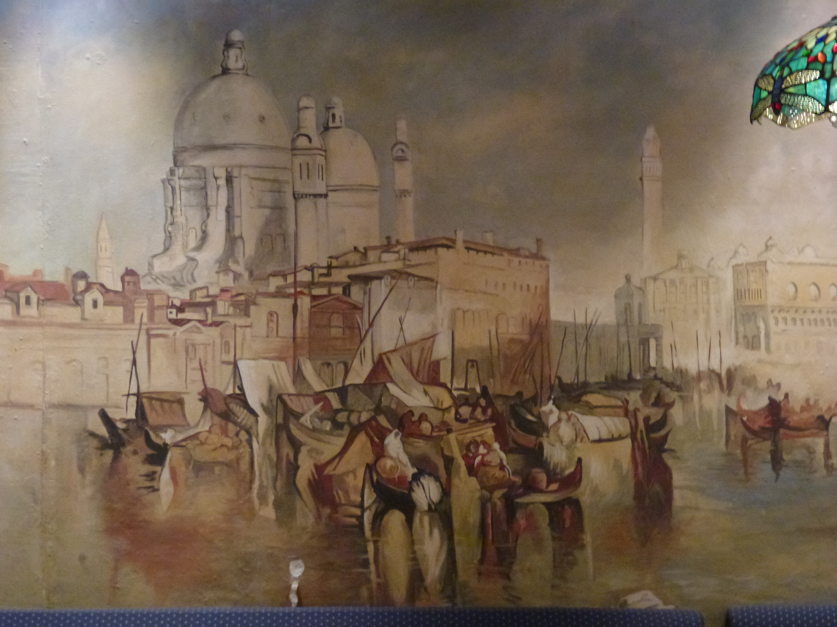
Public Support for Free Learning: A Policy Framework
Stephen Downes
October 25, 2011

Slide 2
Open Learning
Long associated with distance learning
correspondence schools – 1880sff
1915, creation of the National University Extension Association(NUEA)
U.S. radio broadcasting licenses to 202 colleges, universities, and school boards – 1920s, 30s
1926, historian J C Stobart wrote a memo advocating a 'wireless university’ while at BBC
Bizhan Nasseh, A brief History of Distance Education, http://www.downes.ca/files/nasseh_history.html
History of the OU, http://www8.open.ac.uk/about/main/the-ou-explained/history-the-ou

Slide 3
Open Institutions
Open University opens in 1971
did not insist on prior educational qualifications
required students to take two foundation courses
New York State’s Empire State College
commenced operation in 1971
Athabasca University (1970/72), Indira Gandhi National Open University (1985)
Empire State College, College History http://alumni.esc.edu/inauguration/collegehistory.php
IGNOU http://www.ignou.ac.in/ignou/aboutignou/profile/2

Slide 4
Open Learning (2)
Over time – enhanced accessibility
distance learning
reduction of financial barriers
tuition reductions
subsidies
progressive pedagogies
Creation of distance learning pedagogies – Moore, Merrill, Gagne

Slide 5
Open Resources
Project Gutenberg
Open Archives Initiative
BOAI
DSpace
Wikipedia
Curricki
Wikiversity
WikiEducator – Commonwealth of Learning

Slide 6
The OERu Logic Model
Taylor, J.C. 2007. Open courseware futures: Creating a parallel universe. e-Journal of Instructional Science and Technology (e-JIST), Vol 10, No. 1. Online: http://www.ascilite.org.au/ajet/e-jist/docs/vol10_no1/papers/full_papers/taylorj.htm

Slide 8
Criticism of the Logic Model
Traditional Curricular based approach
a focus on articulation & credit transfer
closed federation of traditional institutes
Tight link to traditional credentials
The Black Box problem – ‘open’ this or that (eg. ‘open business model’) unstudied and undeveloped

Slide 9
Contrasts in Design
Learning objectives
concrete and stated Learning Objectives vs. unstated and multiple objectives
Organization of subject matter
knowledge of vs knowledge about
linear organization vs knowledge community

Slide 10
Contrast in Assessment
Subject and content-focused assessment, vs. performance-based and networked-based
Assessment against external criteria vs. self-assessment
Assessment by-instructor vs. 3rd-party assessment

Slide 11
Free Learning
Based on the principles of connectivist, or network, learning
Network design principles: distributed, disintermediated, dynamic
Design based on the ‘semantic principle’:
autonomy
diversity
openness
interactivity

Slide 12
Connectivist Learning Design
A non-curricular based approach
course content is the ‘McGuffin’ vs (Freire) the ‘banking system’
learning takes places through interaction and creativity
Seymour Papert – constructionism
Aggregate, remix, repurpose, feed forward
Learning a matter of growth, not accumulation

Slide 13
But… why
It’s a formal recognition that people have different destinations, different tastes
Based on an understanding that knowledge varies according to these
Expresses the principle that networks – communities – are stronger with multiple diverse perspectives
Knowledge learned is better – indeed, known

Slide 14
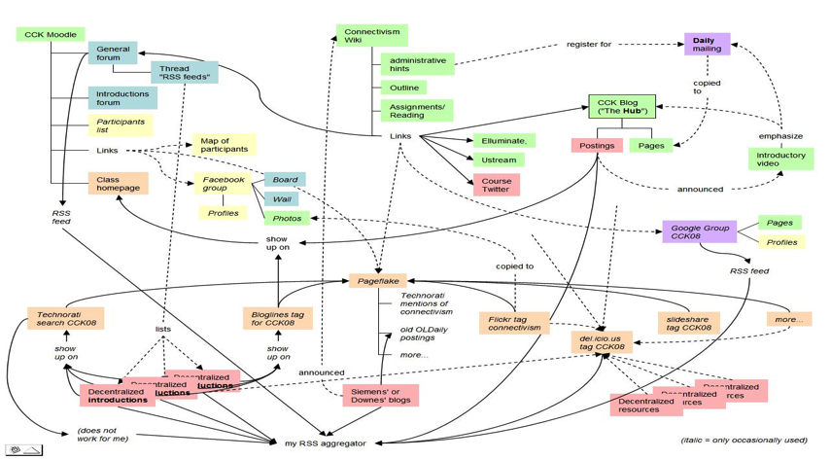
A Map of the Community
Connectivism: A Theory of Personal Learning
Stephen Downes, December 3, 2008, Educational Development Centre, Ottawa
http://www.downes.ca/presentation/208

Slide 15
The MOOC Model
MOOC: Massive Open Online Course
There is no central core feature – no core content, group, etc
Course design is a network, or a map, or a community
Resources are distributed, and aggregated
Participants are encouraged to create their own resources, communities, groups

Slide 16
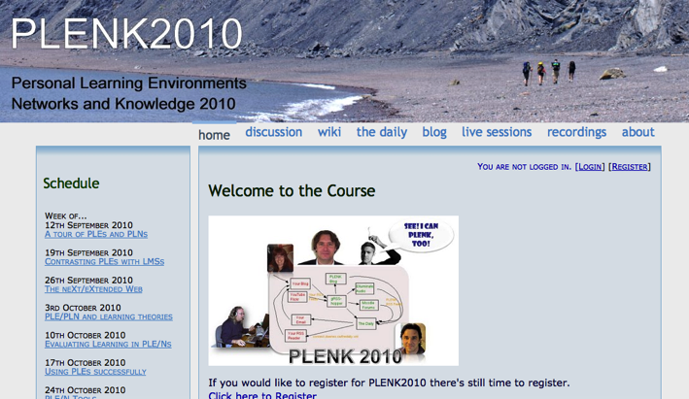
2010: Stephen Downes, Rita Kop Critical Literacies & PLENK 2010
PLENK 2010 involved a significant research effort
http://connect.downes.ca/

Slide 17
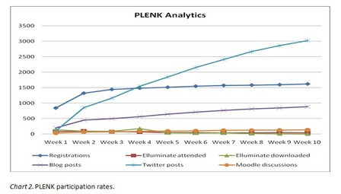
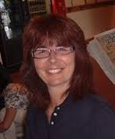
PLENK Analytics
Rita Kop
Supporting ongoing MOOC participation
http://www.irrodl.org/index.php/irrodl/article/view/882

Slide 18
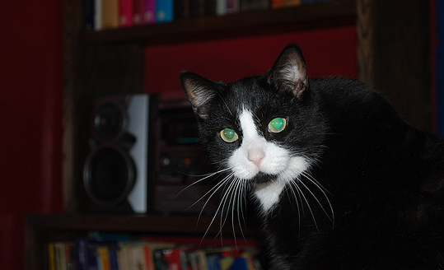
Critical Literacies
Understanding how we use artifacts to communicate in online and other learning networks
http://www.downes.ca/presentation/232

Slide 19
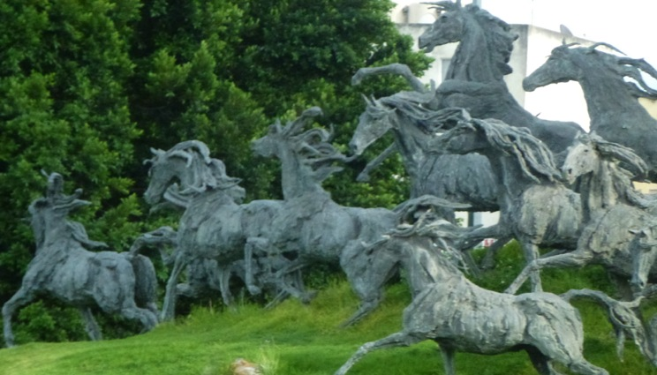
2011: Year of the MOOC

Slide 20
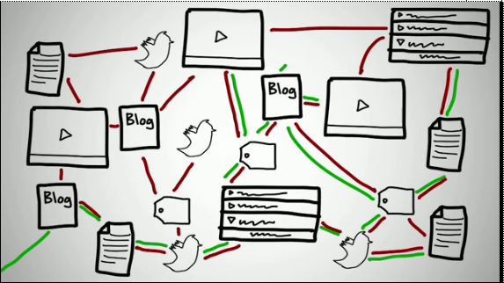
Connectivism & Connective Knowledge
CCK11: How to Learn in a MOOC
http://www.youtube.com/watch?v=eW3gMGqcZQc

Slide 21
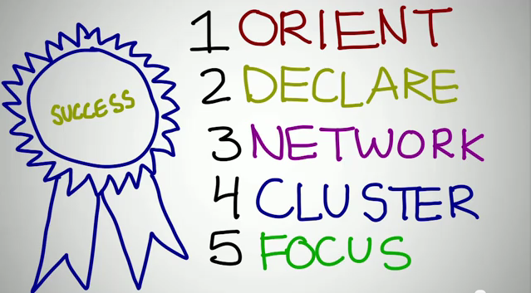
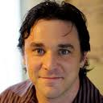
How to be Successful in a MOOC
Dave Cormier
http://www.youtube.com/watch?v=r8avYQ5ZqM0

Slide 22
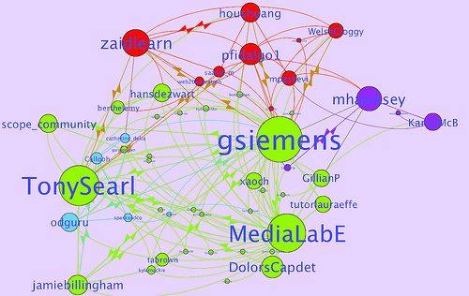
Learning Analytics
LAK11: How to measure success in a MOOC
http://scope.bccampus.ca/course/view.php?id=365

Slide 23
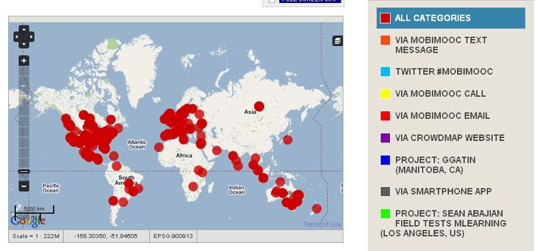
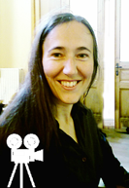
MobiMOOC
Inge de Waard
Supporting Mobile Learning Technology
http://mobimooc.wikispaces.com/

Slide 24
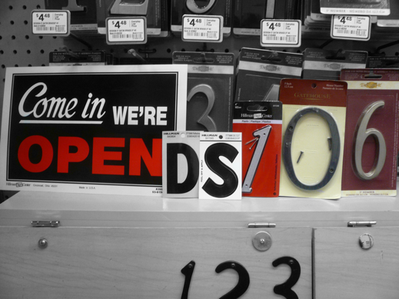
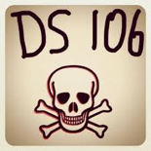
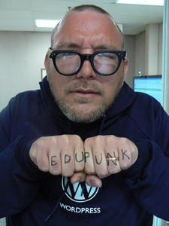
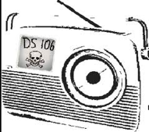
The madness and mayhem of DS106
Jim Groom
DS = Digital Storytelling
DS106 redefined activities and participation
http://ds106.us/

Slide 25
eduMOOC
Large, well publicized, but not very interactive
http://sites.google.com/site/edumooc/

Slide 26
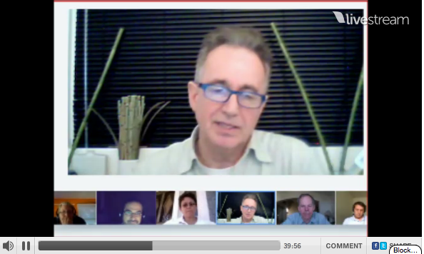
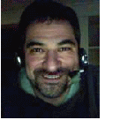
eduMOOC underground
Jeff Lebow
Jeff Lebow, Google+ hangout, and Livestream:
Taking something ordinary, and making it something special – YOU make the MOOC
http://www.livestream.com/jefflebow/

Slide 27
AI-Class: Redefining Massive
More than 100,000 people signed up for pre-registration
http://www.ai-class.com/

Slide 28
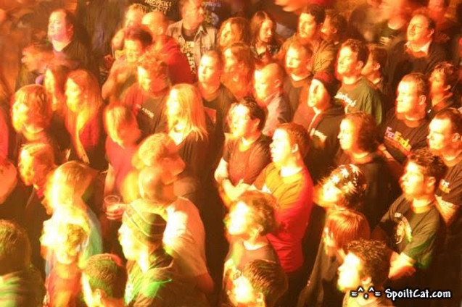
Change 2011
Downes, Cormier and Siemens try again
Image: http://steve-wheeler.blogspot.com/2011/04/running-mooc.html
http://change.mooc.ca

Slide 29
New Roles for Government
Communications and Education Infrastructure
Support for Open Educational Resources
Support for Free Learning
Management of assessments and credentialing

Slide 30
The Digital Infrastructure
Public high-speed backbone networks
used not only for education but for other public services: police, fire and emergency, hospital, municipalities, etc.
Local Access
eg. CAP Centres
Legal Framework
policy on digital rights and copyright
net neutrality and similar regulations

Slide 31
A Note on Sustainability
Whatever we really want is sustainable
Like, say, highways

Slide 32
Sustaining Infrastructure
Support for existing programs and services
cost reductions in communications overhead
improved efficiency of public service delivery
Overhead on entertainment and commercial infrastructure
similar to broadcast ‘CanCon’ requirements

Slide 33
Open Educational Resources
Traditional Resources
Already developed and paid for by government
Open access initiatives
Public Policy Resources
design to serve a public end or objective
focus on basic literacies & community empowerment

Slide 34
Sustaining OERs
Redirection of existing resource allocations
eg. OA mandates for grants and programs
community outreach for existing agencies
eg, NASA
Support for community-based OER process
integration of OER development and use within publicly supported curricula
use of OERs in public services and programs
- Stephen Downes, Models for sustainable Open Educational Rsources, ijklo.org/Volume3/IJKLOv3p029-044Downes.pdf http://www.downes.ca/presentation/76
- OER Help with Keynote Slides, OER-Forum http://lists.esn.org.za/pipermail/oer-forum/2011-October/thread.html

Slide 35
Software and Service Support
Software and environment support
eg. Public Knowledge Project,
Open Journal Systems, Moodle, et
Service networks and support
JISC / CETIS, EdNA, etc.
Common Services - eFramework

Slide 36
Sustaining Support Systems
Development and systems research support
Public adoption of open licensing
FLOSS
GNU/GPL, BSD, etc
Creative Commons
directs resources toward multi-sector development
Community service requirement for commercially sourced software

Slide 37
Assessment and Credentialing
Major policy initiatives
separation of delivery and assessment
an end to Digital Diploma Mills
management of credentialing by professional associations under a regulatory framework
development of community-based assessment metrics and infrastructure
move away from simple testing, toward authentic community engagement and referrals

Slide 38
Assessment and Credentialing (2)
Support for Personal Learning
provision of personal learning environments and frameworks
promote lifelong learning
link to skills database, corporate training registries
direct support for employment and funding
personal portfolios and credential banks
voluntary, self-managed
optional identity frameworks

Slide 39
The Old School 2.0
School 2.0 etoolkit http://etoolkit.org/etoolkit/

Slide 40
New Models for Schools

Slide 41
New Roles for Research

Slide 42
Community = Interactions
Not ‘spreading the word’
Not ‘amplification’
But rather, the creation of our own society, together
emergent from the free actions of each of us
not based on the ideas of one (or a small number) of individuals

Slide 43
Open Communities are Free
Dave Pollard, the Metamovement http://howtosavetheworld.ca/2011/10/20/the-metamovement-moving-beyond-marches-and-people-in-the-street/

Slide 44
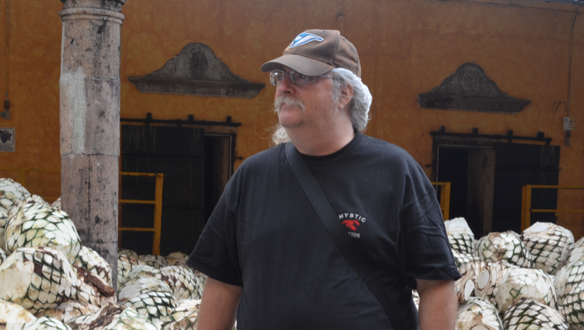
Stephen Downes http://www.downes.ca

